Slide 1

教学辅助课件
牛津 七年级下

Slide 2


Unit 1
Dream homes
to the unit

Slide 3


Words review
palace
next to
town
Canada
France
Japan
n. 皇宫，宫殿
prep. 紧邻，在……近旁
n. 镇，城镇
n. 加拿大
n. 法国
n. 日本
Read after the tape and speak out the Chinese immediately

Slide 4
Words review
Russia
UK
London
country
capital
n. 俄罗斯
abbr. (=United Kingdom)
英国
n. 伦敦
n. 国家
n. 首都

Slide 5
Objectives
To get the general information about the six places of interest on page 7, including the names, the cities/capitals and the countries
To be able to talk about countries and capitals
To learn the new words and useful expressions

Slide 6
Focus on
Words:
favourite capital
Expressions:
next to would like
Patterns:
1 —Would you like to live in a palace?
— Yes/No. I’d like to live next to a restaurant.
2 —Is Tokyo the capital of Japan?
—Yes, it is./No, it isn’t.

Slide 7
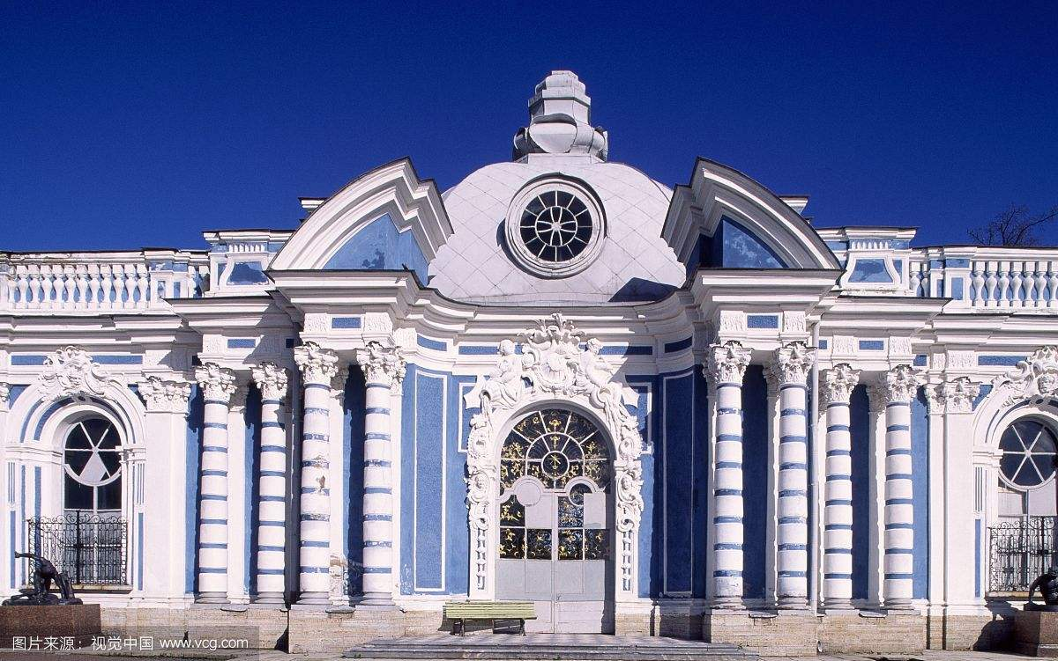
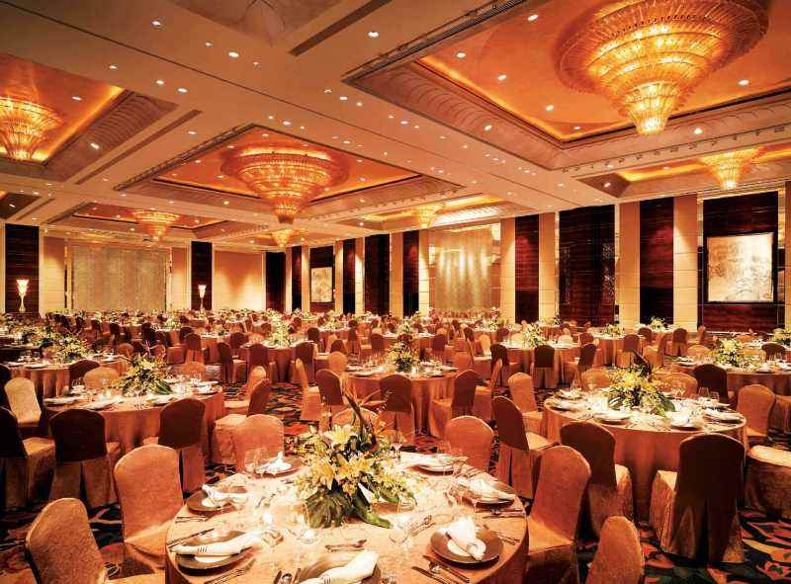
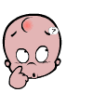

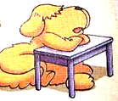
next to a restaurant?
in a palace?
He would like to live next to a restaurant. Because he likes eating.
Listen and get the answer.
Why?

Slide 8
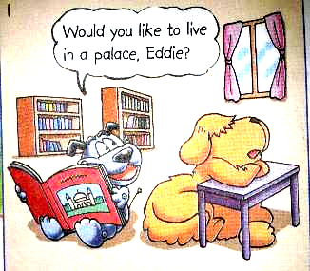
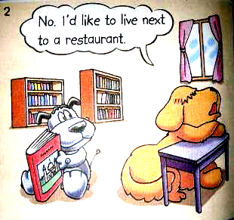
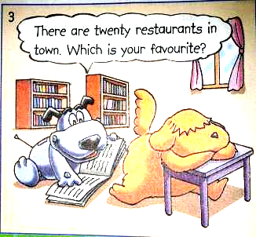
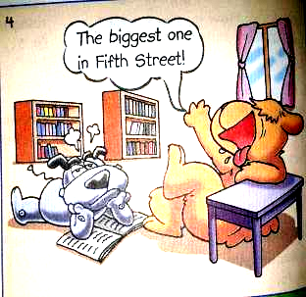
would like +动词不定式：“想要做……”
Observe-and-explain
next to: beside, nearest in space“紧邻，在……近旁”
favourite n.特别喜爱的人（或物）

Slide 9
Act it out
1. Use different tones (语气).
2. Add your own actions to make the dialogue more interesting.

Slide 10



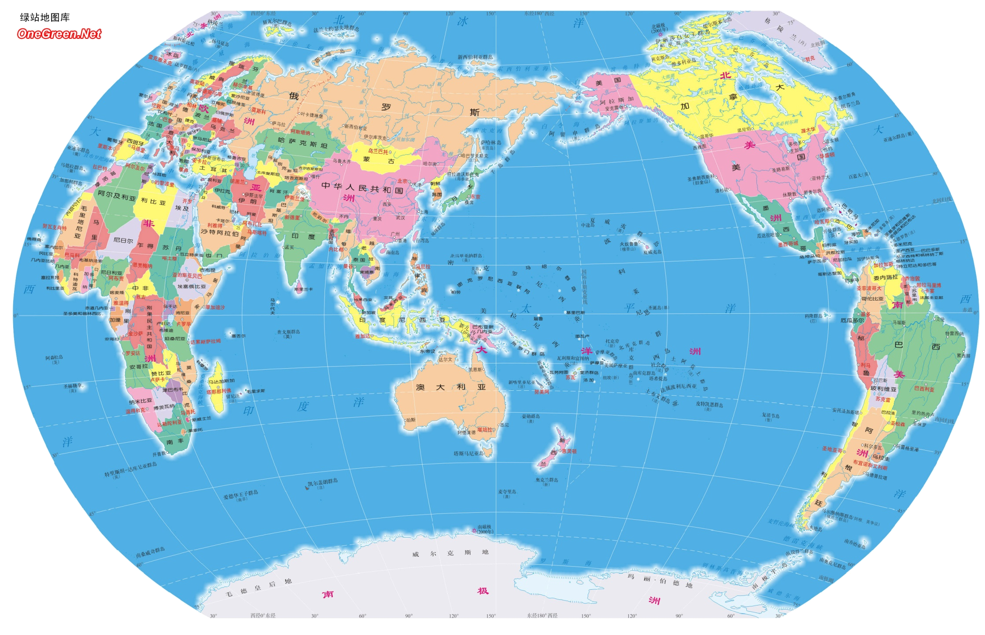
There are more than 200 countries in the world. Which country would you like to live in?
I’d like to live in ….

Slide 11

Here are some photos of countries. Let’s enjoy them and answer the following questions.
A
What’s it in the photo?
Which country is this photo from?
Which city is this photo from?

Slide 12
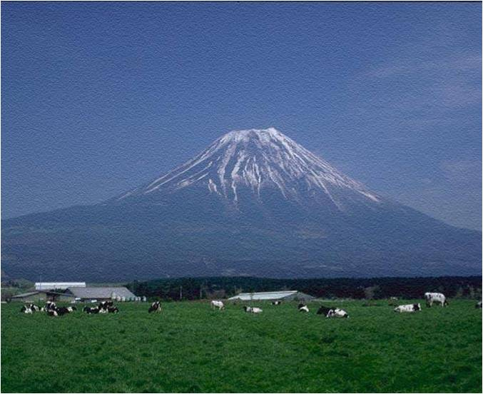
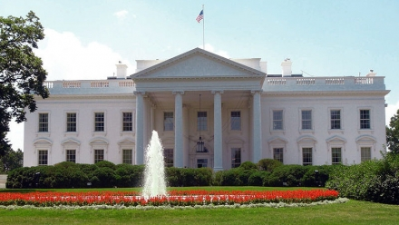
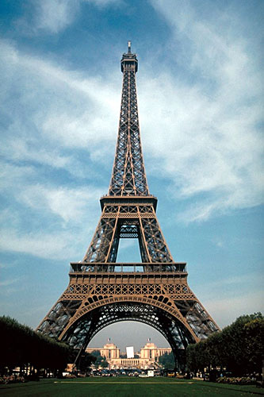
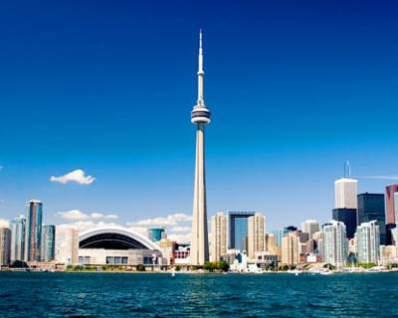
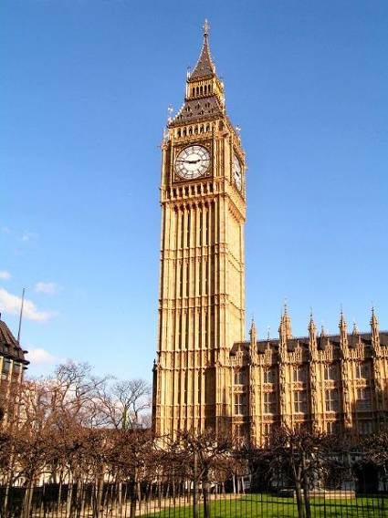
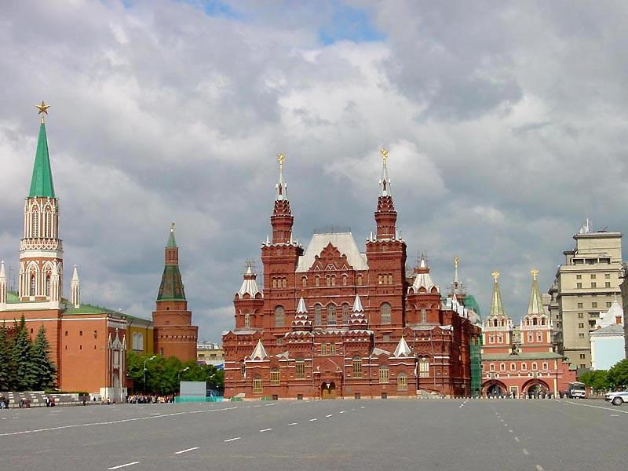

Slide 13
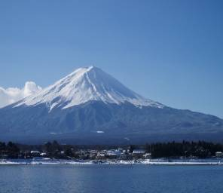
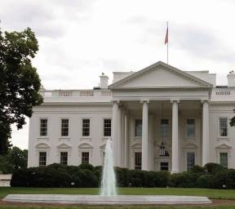

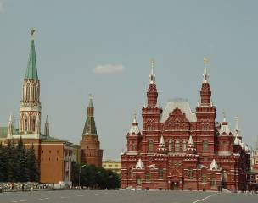

Mount Fuji
the White House
the Eiffel Tower
Tokyo
Paris
Washington DC
These places of interest are in their capitals.
The CN Tower is in Toronto. But the capital of Canada is Ottawa.
Japan
the USA
France
the CN Tower
Big Ben
Red Square
Toronto
London
Moscow
Canada
the UK
Russia

Slide 14

B
Simon’s cousin, Annie, is asking Simon questions about the places in Part A. Listen and answer the questions.
1. What country are they talking about?
2. What’s it in the photo?
3. Is Mount Fuji in Tokyo?
They’re talking about Japan.
It’s Mount Fuji.
No. It’s near Tokyo.

Slide 15
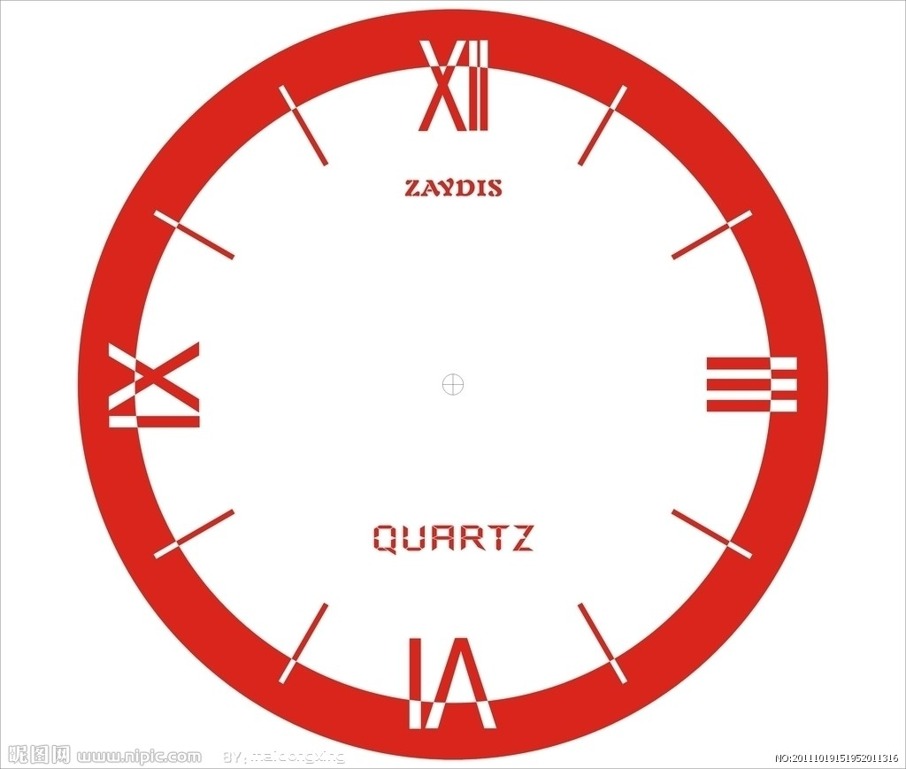

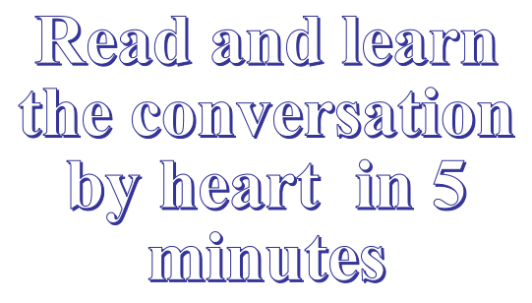

Slide 16

Role-play
We’ll see which group does the best.
Annie
Simon
Which ______ is this photo from, Simon?
Oh, it’s from Japan. ____ __ Mount Fuji.
I see. Where is it?
It’s ________ Tokyo.
Yes, ____ ____.
Is Tokyo __ _____ __ Japan?

Slide 17
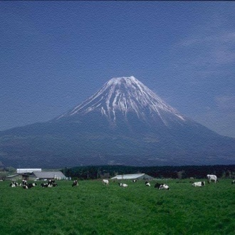
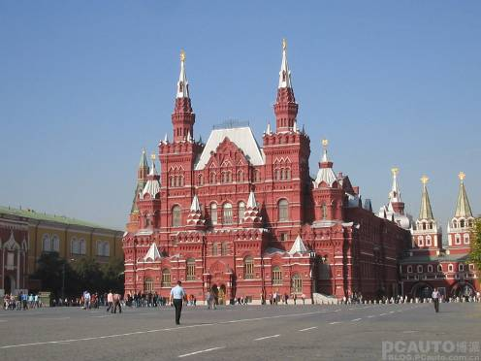

Mount Fuji
Japan
Tokyo
the CN Tower
Canada
Toronto
Big Ben
the UK
London
the White House
the USA
Washington DC
Use the conversation on page 7 as a model. Work in pairs and make your own conversations.
Red Square
Russia
Moscow
the Eiffel
Tower
France
Paris
A: Which country is this photo from?
B: Oh, it’s from ....This is ....
A: I see. Where is it?
B: It’s near/in ....
A: Is … the capital of … ?
B: Yes. it is./ No, it isn’t. The capital of …is ….
A: Would you like to live…?
B: Yes. / No, I would like to live in ….
pair work

Slide 18
Language points
1. Would you like to live in a palace, Eddie?
①would like意为“愿意；想要”，没有人称和数的变化。would在主语后常缩写为’d。
②would like to do sth.表示“想要做某事”
1) I would like to live on Mars．
但愿我能住到火星上去.
2) I’d like to buy Mum a nice present.
我想给妈妈买个漂亮的礼物。

Slide 19

2. I’d like to live next to a restaurant.
next to是方位介词，意为“紧邻，在……近旁” ，后面直接加名词，在句中作地点状语或表语。
practice
1) 汤姆住在丹尼尔隔壁。
Tom lives next to Daniel.
2) 我们班与他们班紧邻。
Our class is next to theirs.

Slide 20

Quiz
注: 另附word文档。
点击此处链接

Slide 21
I.英汉互译
1. 梦想之家 ___________
2.最大的一个 ___________
3.餐厅 ___________
4.the White House ___________
5.Big Ben ___________
6.Red Square ___________
7.in town ___________
dream homes
the biggest one
restaurant
白宫
大本钟
红场
在城镇

Slide 22
II.根据所给的汉语意思完成句子。
1. 伦敦是英国最大的城市。
______ is the _______ city in the ___.
2. 和中国一样，加拿大也是个很大的国家。
Like China, _______ is a very large
_______, too.
3. 华盛顿特区是美国的首都。
Washington D.C. is ___ ______ ____
the USA.
4. 我想住在天一广场附近。
I __ ____ to live ____ ___ Tianyi Square.
London biggest UK
Canada
country
the capital of
’d like next to

Slide 23
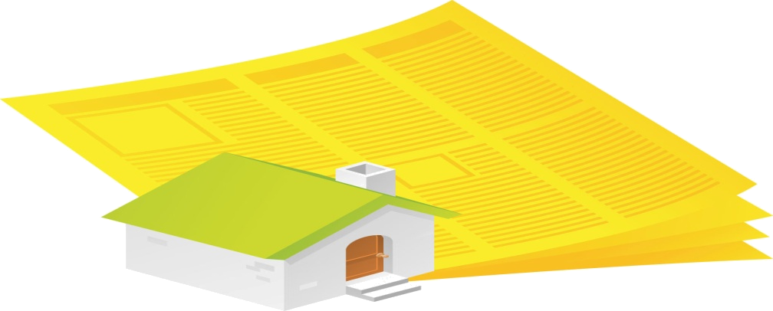
Homework
1. Learn the new words and expressions
by heart.
2. Finish the exercises in Learning English.
3. Preview the blogs of three students
on page 8.

